Slide 1
Modeling for Automatic Control and Estimation of Influx and loss During Drilling Operations
Christian Berg

Slide 2
Overview
List of publications
Drilling
Pressure Control and Influx and Loss
Modeling of drilling hydraulics
Well control
Summary

Slide 3
List of Publications
Paper A Model-based drilling fluid flow rate estimation using Venturi flume
Flow measurement for conventional drilling operations for kick/loss detection
Paper B Modified Godunov-type Scheme for a Two-Phase Flow in a Nozzle with Variable Cross Section
Numerical solution of the drift-flux model with source terms
Paper C A Well-Balanced Godunov-Type Scheme for the Euler Equations and the Drift Flux Model with Laminar Friction and Gravitation
Numerical solution of the drift-flux model with source terms
Paper D Pressure wave propagation in Managed Pressure Drilling- model comparison with real life data
Comparison of distributed and simplified single phase models with field data for fast pressure dynamics
Paper E The Influx Management Envelope Considering Real Fluid Behaviour
Decision making support for influx management during MPD operations
Paper F Cascaded Bottom Hole Pressure Control in Managed Pressure Drilling
Application of simple model for control design and performance in practice
Paper G Automated Pressure Control for UBD Operations: Case study and Field Validation
Application of simple model for control design and performance in practice under multiphase conditions

Slide 4
Main topics
Pressure Control and Influx and Loss Paper A and F
Modeling of drilling hydraulics
Paper B, C and D
Well Control
Paper E and G

Slide 5
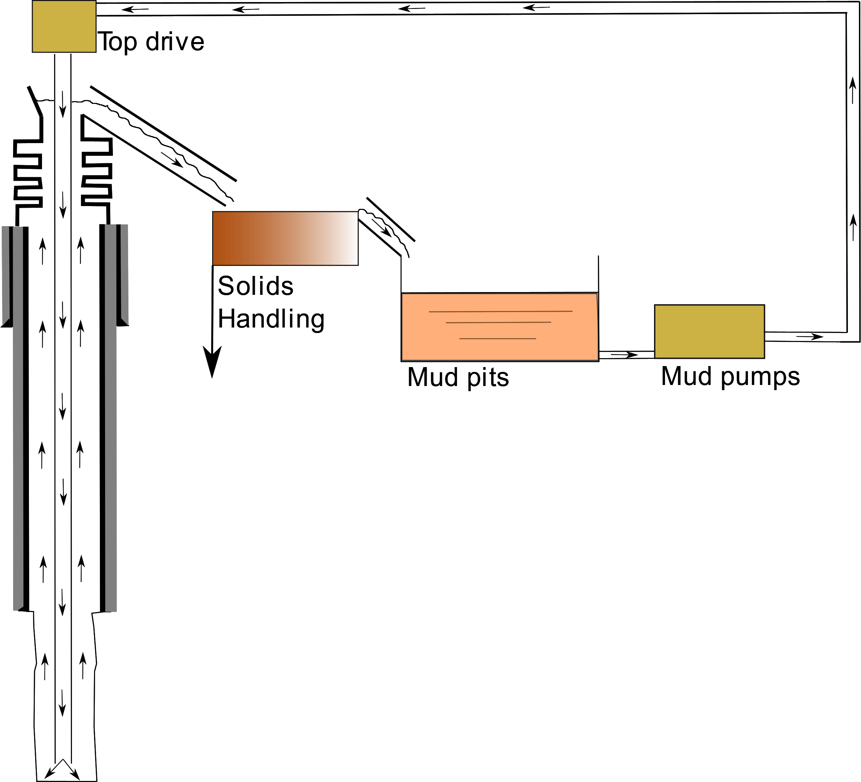
Conventional Drilling
Drilling fluid “mud” is circulated continuously down the drill string, cooling the bit and transporting cuttings to the surface
Pressure inside the well controlled by drilling fluid density (affecting hydrostatic pressure)
Open circulation system!

Slide 6
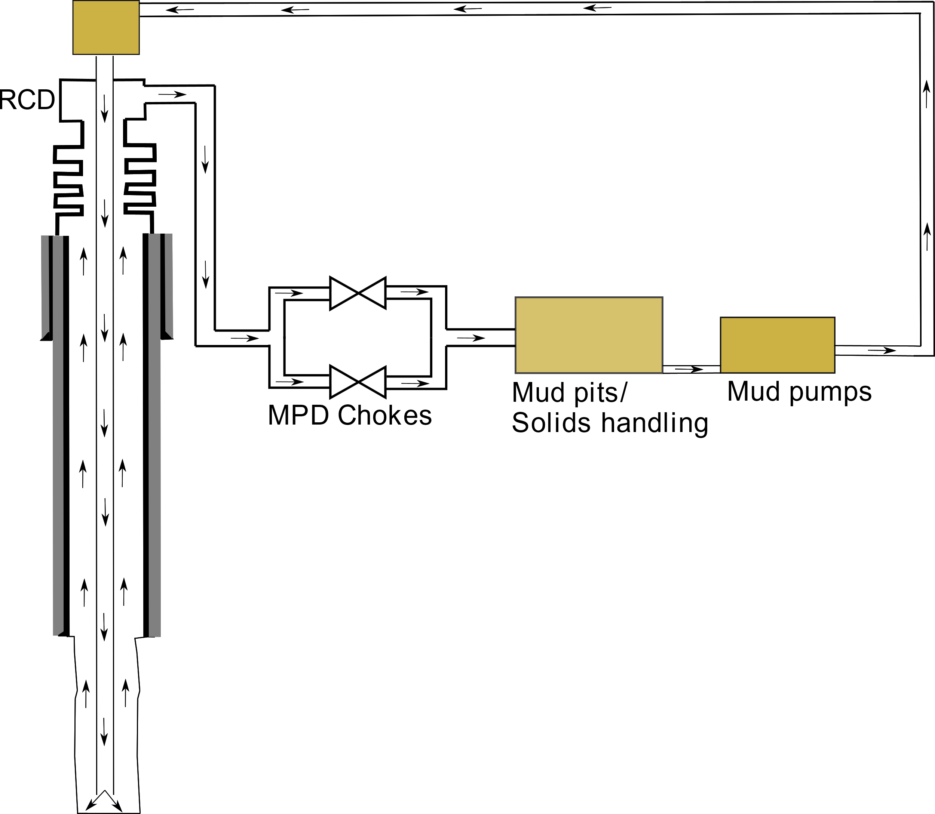
Managed Pressure Drilling
Closed circulation system
Pressure inside well controlled by density of drilling fluid and applied surface pressure
Similiar to a «conventional» setup performing well control operations

Slide 7
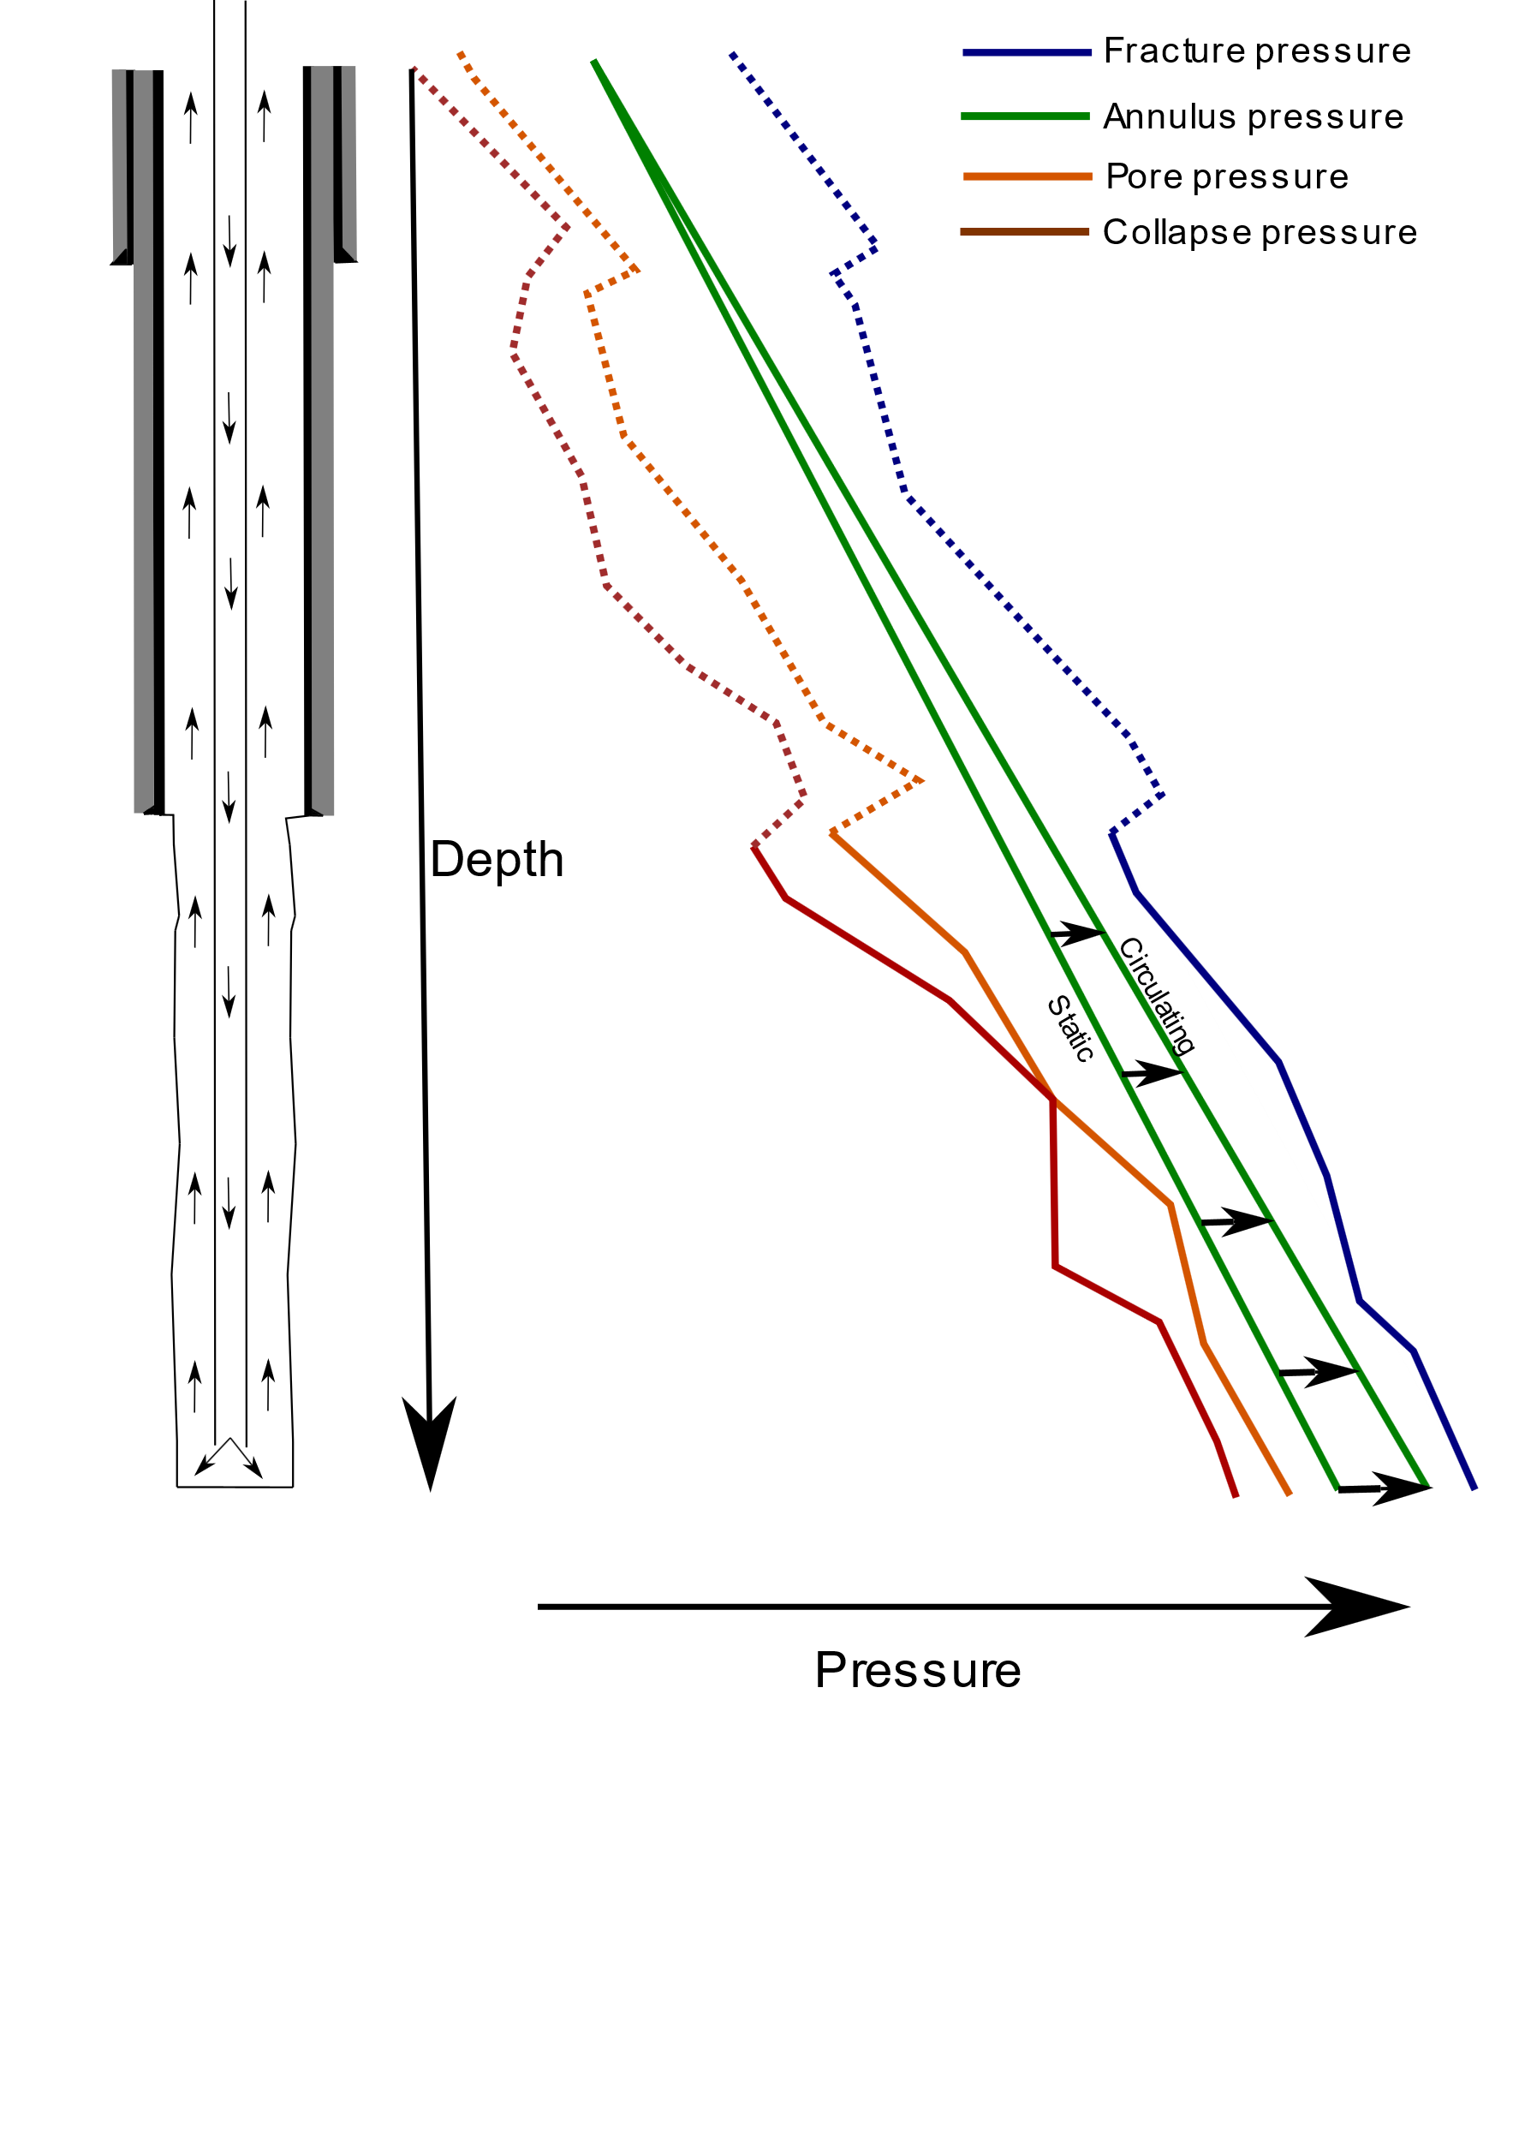
Influx and Loss
Conventional
If downhole pressure is lower than pore pressure
Influx of formation fluids into the well
If downhole pressure is higher than fracture pressure
Loss of drilling mud into the formation
Measured/Estimated through a miscompare between flow in and out of the well

Slide 8
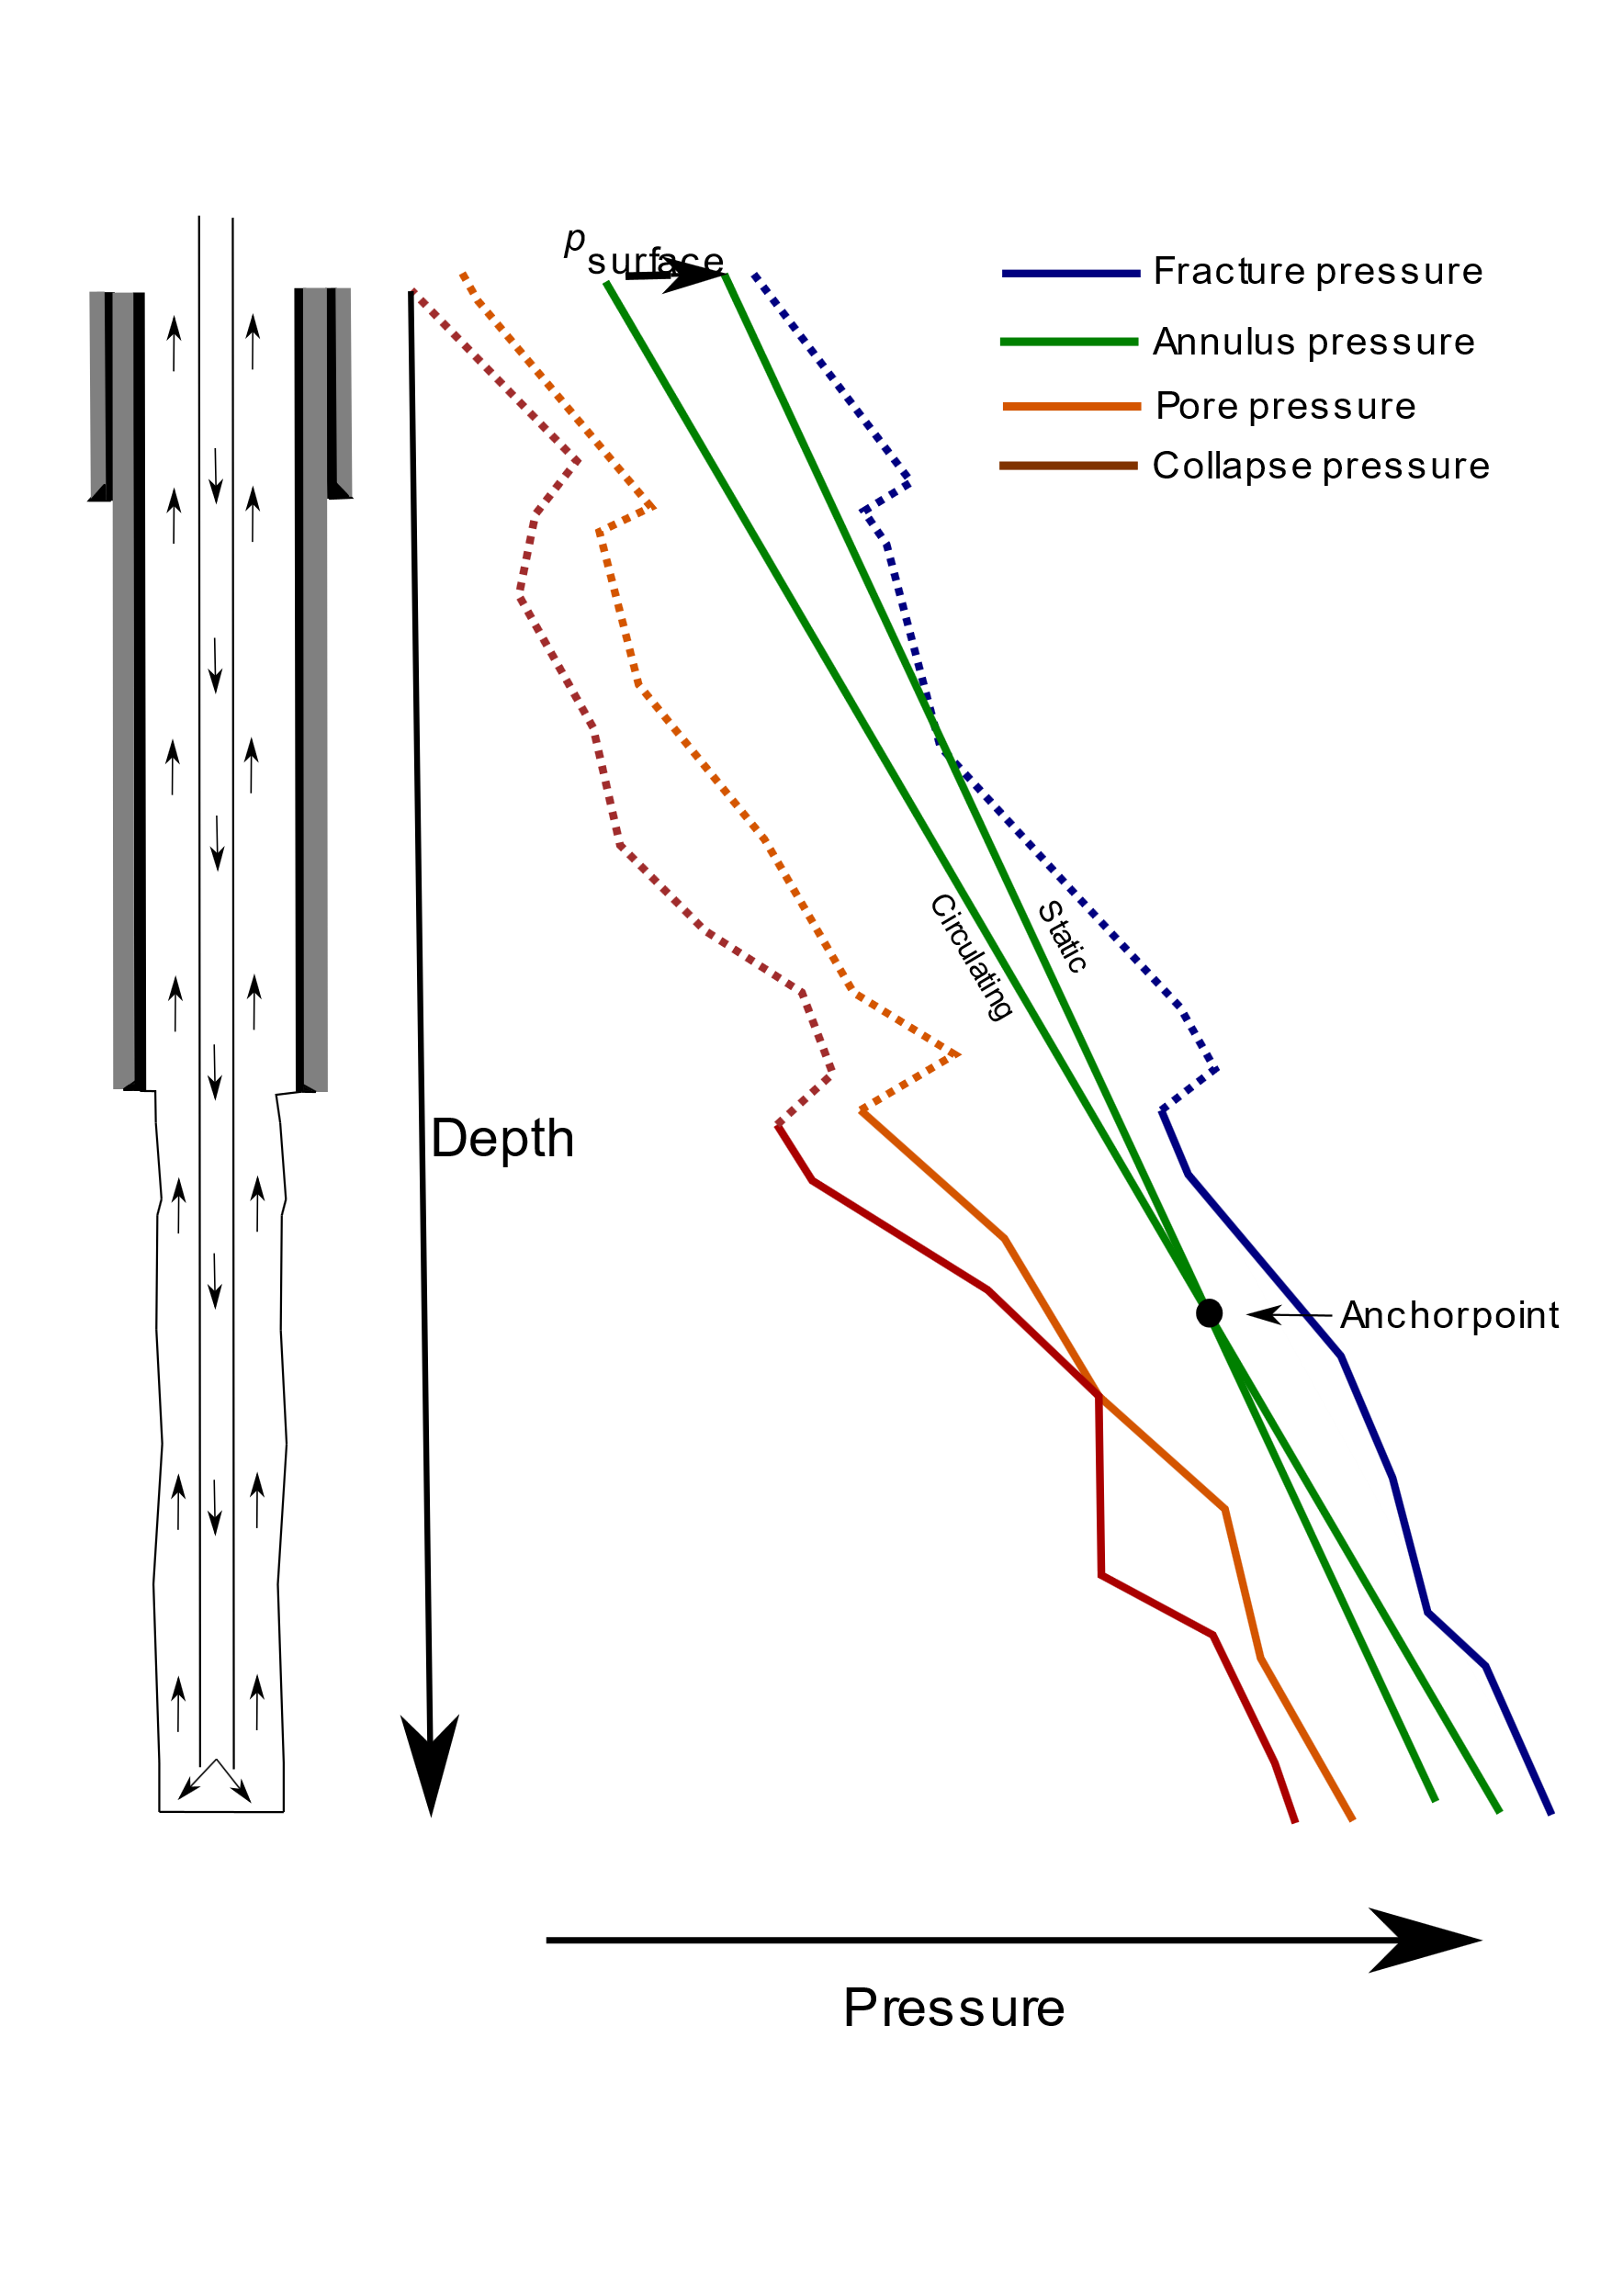
Influx and Loss
MPD
If downhole pressure is lower than pore pressure
Influx of formation fluids into the well
If downhole pressure is higher than fracture pressure
Loss of drilling mud into the formation
Measured/Estimated through a miscompare between flow in and out of the well

Slide 9
Influx and Loss
Challenges with conventional
For conventional drilling, return flow measurements have low accuracy
Mainly useful as a qualitative indication
Flow measurement for open channel flow is not trivial
2 degrees of freedom
Liquid level
Liquid velocity
In a lot of civil engineering applications, this is solved by sub/super critical flumes
The application of this to drilling is the topic of Paper A [1]

Slide 10
Overview
List of publications
Drilling
Pressure Control and Influx and Loss
Modeling of drilling hydraulics
Well control
Summary

Slide 11
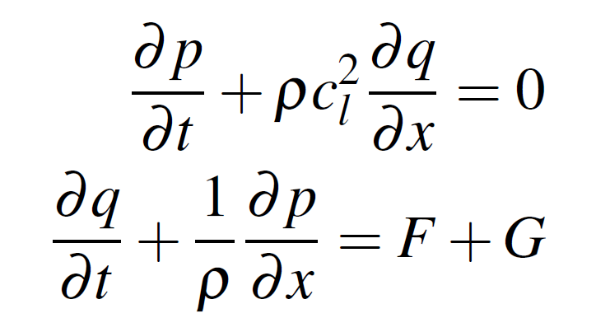
Modelling of Drilling Hydraulics
Single phase system can be described by the 1D isothermal Euler Partial Differential Equations (PDE’s) [2]
And simplified to the water-hammer equations

Slide 12
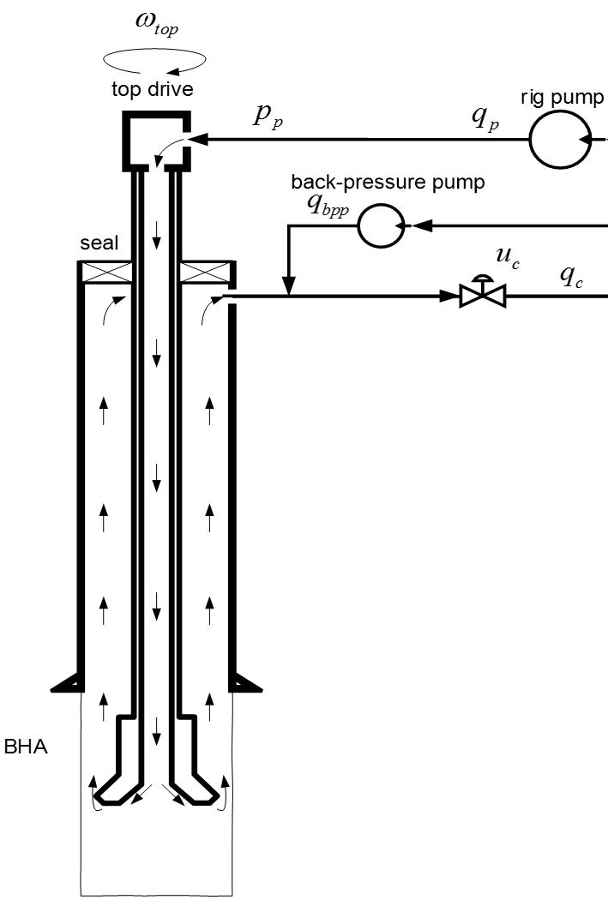
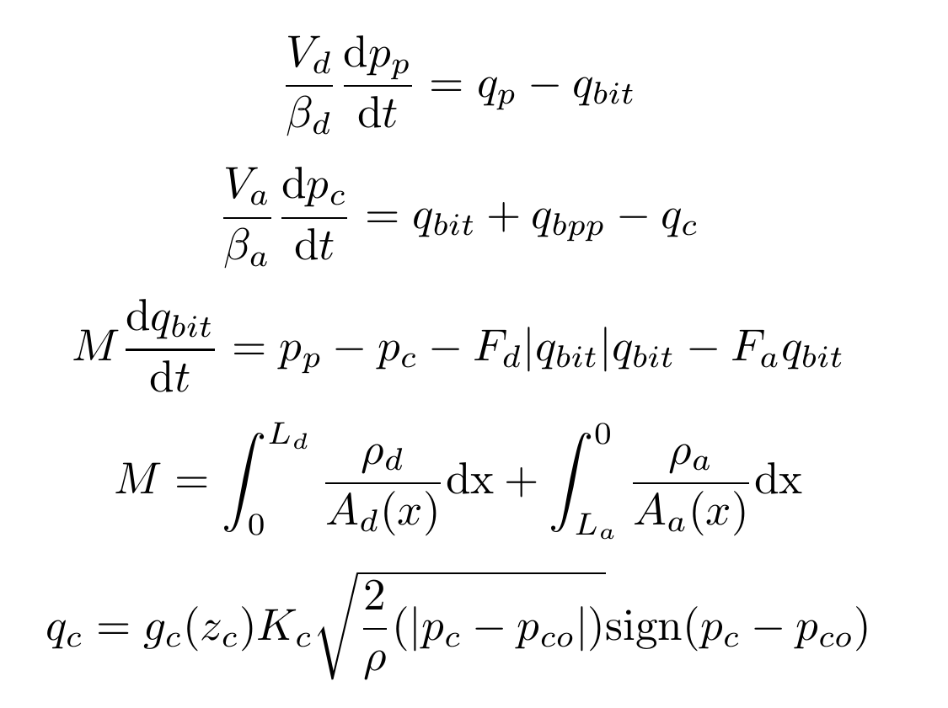
Modelling of Drilling Hydraulics
Most commonly used model [3]
$$q_{bit}$$

Slide 13
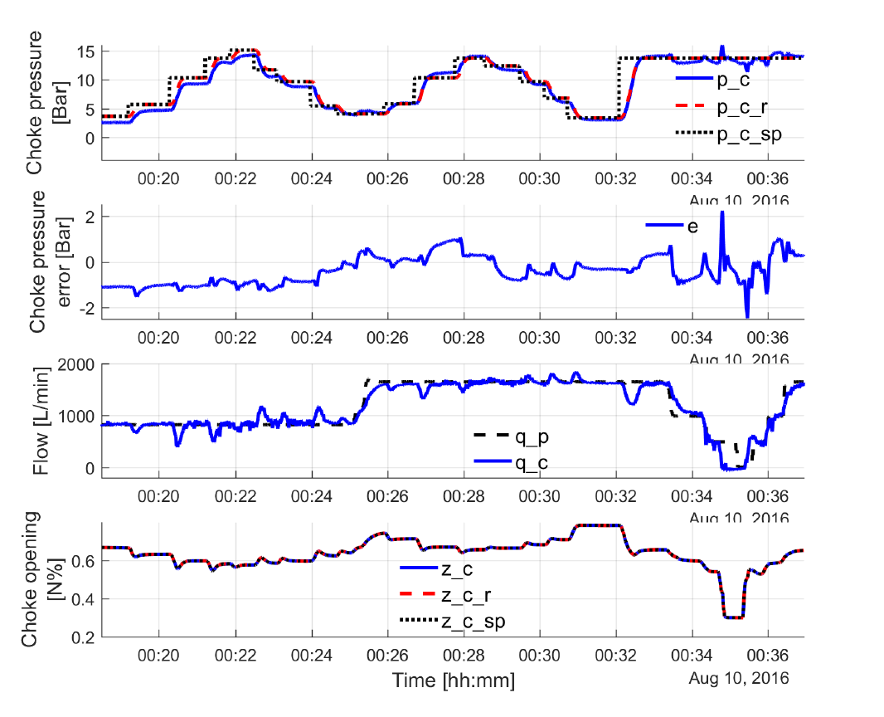
Modelling of Drilling Hydraulics
Using the simplified model for controller design works well [4,5]
Field testing of a controller based on the simplified model is described in Paper G [6]

Slide 14
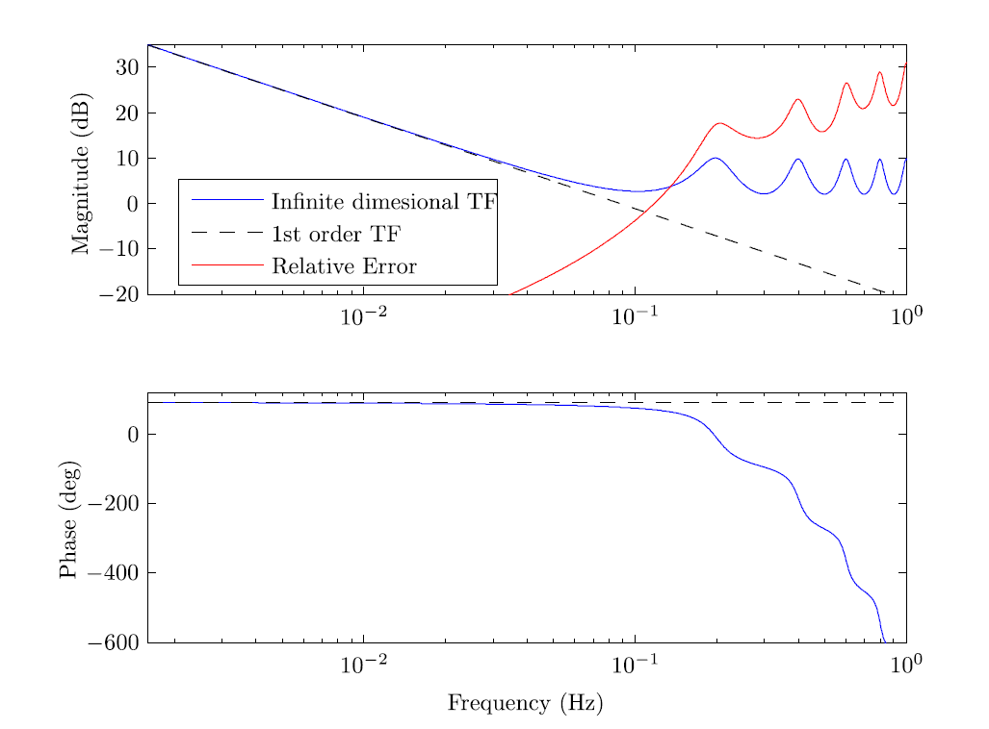
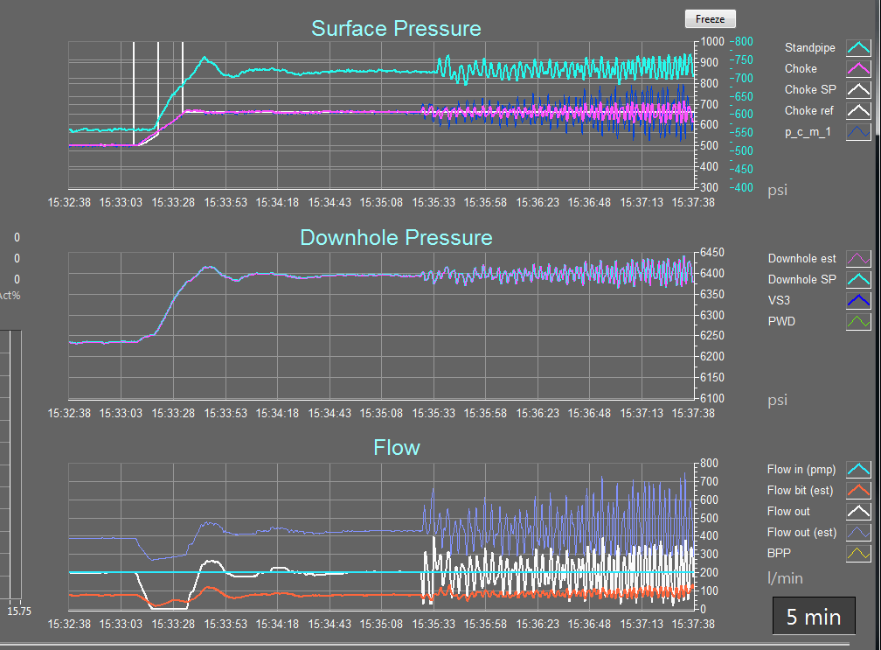
Modelling of Drilling Hydraulics
The simple ODE model has some limits that should be respected [1]
Aarsnes, Ulf Jakob “Modeling of Two-Phase Flow for Estimation and Control of Drilling Operations.” PhD Thesis, Norwegian University of Science and Technology, 2016.

Slide 15
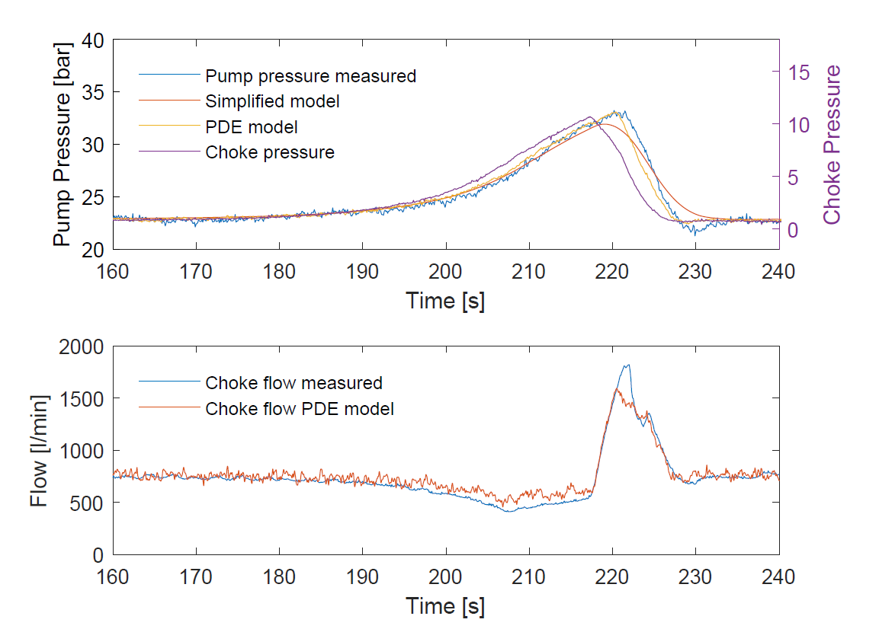
Modelling of Drilling Hydraulics
These phenomena are also very much visible in real operations
Comparison of the simplified model, 1D isothermal Euler PDE and modifications to the PDE to account for simple mechanical interactions is the topic of Paper D [7]

Slide 16
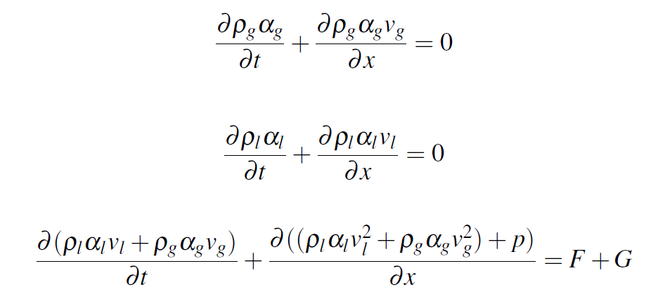
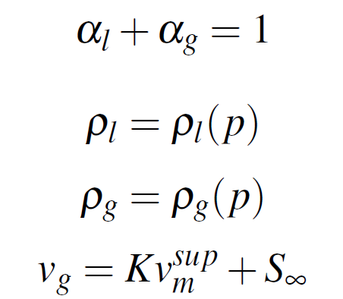
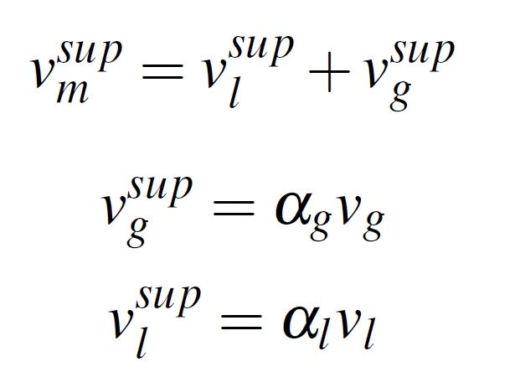
Modelling of Drilling Hydraulics
If modeling the system after an influx of gas, a multi-phase model is required.
The Drift-Flux Model (DFM) is the most commonly used [2]

Slide 17
Modelling of Drilling Hydraulics
The DFM cannot be easily transformed into a linear PDE system without losing important dynamics (as opposed to the single phase liquid case)
Numerical methods that work well for non-linear PDE systems often work well primarily for «Conservation» systems [8]
Without source terms
The DFM has source terms and is challenging to solve

Slide 18
Modelling of Drilling Hydraulics
Numerical solution schemes that work well with sources are usually termed «well-balanced»
How to construct well balanced schemes for the DFM is described in Paper B and C [9,10]
Being well balanced in the presence of discontinous cross sectional area changes is «solved» in Paper B [9]
A generic approach to well balanced with friction and gravity source terms is still an open problem but we made progress in Paper C [10]

Slide 19
Overview
List of publications
Drilling
Pressure Control and Influx and Loss
Modeling of drilling hydraulics
Well control
Summary

Slide 20
Well Control
Using Managed Pressure Drilling equipment to deal with «well control» is promising and often faster than conventional well control [11,12]
Significant industry shift in acceptance the last 5 years
Should be done with care due to lower pressure rating of MPD system than well control equipment [13]

Slide 21
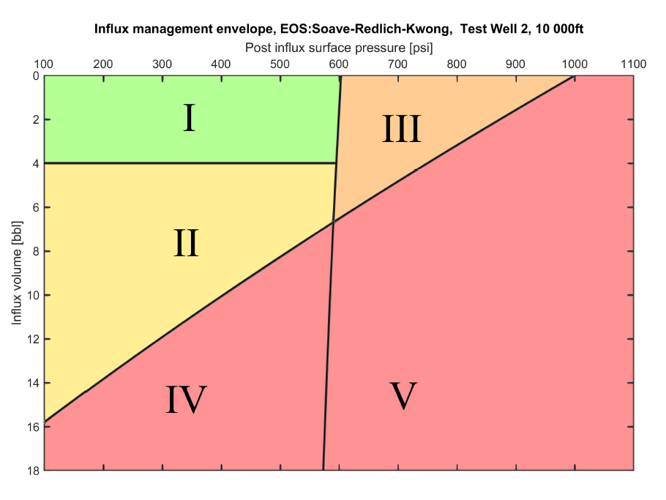
Well Control
The Influx Management Envelope is a decision making tool for dealing with this [11]
The industry wants the IME, and usage has been running ahead of formal treatment in literature
A formal treatment of the IME, with systematic introduction of simplifications and extension to non-ideal gases is described in Paper E [12]

Slide 22
Well Control
When gas has entered the well, the dynamics of the system change considerably [2]
It is found that a controller based on the simple ODE model is sufficient in the multiphase case, as long as system compressibility is treated as «unknown» and time varying and this is dealt with using an adaptive law. Operational testing of this is described in Paper G [14]
Although the operation in Paper G is an underbalanced drilling operation, this is also applicable to conventional well control and Paper G is a natural continuation of the conclusions and future work in Carlsen et al. [15]

Slide 23
Summary
The simple ODE model is sufficient for control designs
But, the neglected dynamics in this model have to be respected with respect to controller tuning
Controllers should be tested extensively on a higher-fidelity model
The simple ODE model with time varying system compressibility is sufficient for control designs for multiphase systems
Controller should be tested extensively on a higher-fidelity multiphase model
Solving this multiphase model is challenging
Significant shift in industry acceptance for using MPD equipment for influx management last 5 years
This is a valuable stepping stone for the possibility of automated well control operations

Slide 24
Thank You
kelda.no

Slide 25
References
[1] Berg, C., A. Malagalage, C. E. Agu, G. O. Kaasa, K. Vaagsaether, and B. Lie. ‘Model-Based Drilling Fluid Flow Rate Estimation Using Venturi Flume’. IFAC-PapersOnLine 48, no. 6 (2015): 171–76. https://doi.org/10.1016/j.ifacol.2015.08.027.
[2] Aarsnes, Ulf Jakob Flø. “Modeling of Two-Phase Flow for Estimation and Control of Drilling Operations.” PhD Thesis, Norwegian University of Science and Technology, 2016.
[3] Kaasa, Glenn-Ole, Øyvind N Stamnes, Ole Morten Aamo, and Lars S Imsland. “Simplified Hydraulics Model Used for Intelligent Estimation of Downhole Pressure for a Managed-Pressure-Drilling Control System.” SPE Drilling & Completion 27, no. 01 (2012): 127–38. https://doi.org/10.2118/143097-PA.
[4] Pavlov, Alexey, Glenn-Ole Kaasa, and Lars Imsland. “Experimental Disturbance Rejection on a Full-Scale Drilling Rig.” IFAC Proceedings Volumes 43, no. 14 (2010): 1338–43.
[5] Stakvik, Jon Åge, Christian Berg, Glenn-Ole Kaasa, Robert Graham, and Antonio Torrealba. “Model-Based Control in Managed Pressure Drilling.” Society of Petroleum Engineers, 2017.
[6] Stakvik, Jon Age, Christian Berg, Glenn-Ole Kaasa, and Ole Morten Aamo. “Cascaded Bottom Hole Pressure Control in Managed Pressure Drilling.” In 2017 IEEE Conference on Control Technology and Applications (CCTA), 2001–7. Mauna Lani Resort, HI, USA: IEEE, 2017. https://doi.org/10.1109/CCTA.2017.8062748.
[7] Berg, Christian, Jon Åge Stakvik, Bernt Lie, Knut Vaagsaether, and Glenn-Ole Kaasa. “Pressure Wave Propagation in Managed Pressure Drilling- Model Comparison with Real Life Data.” In Proceedings of the 60th Conference on Simulation and Modelling (SIMS 59), 8. Linköping Electronic Conference Proceedings No. University of Västerås, Västerås, Sweden: Linköping University Electronic Press, August 13th–15th. https://doi.org/ecp2017091.
[8] Toro, Eleuterio F. Riemann Solvers and Numerical Methods for Fluid Dynamics: A Practical Introduction. Springer Science & Business Media, 2013.
[9] Abbasi, M.H., S. Naderi Lordejani, N. Velmurugan, C. Berg, L. Iapichino, W.H.A. Schilders, and N. van de Wouw. “A Godunov-Type Scheme for the Drift Flux Model with Variable Cross Section.” Journal of Petroleum Science and Engineering 179 (August 2019): 796–813. https://doi.org/10.1016/j.petrol.2019.04.089.
[10] Abbasi, M H, S Naderi Lordejani, C Berg, L Iapichino, and N van de Wouw. “A Well-Balanced Godunov-Type Scheme for the Euler Equations and the Drift Flux Model with Laminar Friction and Gravitation,” n.d., 51. Submitted to Journal of Computational Physics
[11] Culen, M. S., P. R. Brand, W. Bacon, and O. R. Gabaldon. “Evolution of the MPD Operations Matrix: The Influx Management Envelope.” In SPE/IADC Managed Pressure Drilling and Underbalanced Operations Conference and Exhibition. Galveston, Texas, USA: Society of Petroleum Engineers, 2016. https://doi.org/10.2118/179191-MS.
[12] Berg, Christian, Geir Arne Evjen, Naveen Velmurugan, and Martin Culen. “The Influx-Management Envelope Considering Real-Fluid Behavior.” SPE Drilling & Completion, December 1, 2019. https://doi.org/10.2118/198916-PA.
[13] “NTL 2008-G07 - Managed Pressure Drilling Projects.” Bureau of Safety and Environmental Enforcement, May 15, 2008. https://www.bsee.gov/sites/bsee.gov/files/notices-to-lessees-ntl/notices-to-lessees/08-g07.pdf.
[14] Berg, Christian, Jon Åge Stakvik, Stanislav Kulikov, Maytham Badrawi, Glenn-Ole Kaasa, Aleksandr Dubovtsev, Sergey Korolev, and Gurban Veliyev. “Automated Pressure Control for UBD Operations: Case Study and Field Validation.” SPE Drilling & Completion, October 1, 2019. https://doi.org/10.2118/194555-PA.
[15] Carlsen, Liv A., Gerhard Nygaard, and Michael Nikolaou. ‘Evaluation of Control Methods for Drilling Operations with Unexpected Gas Influx’. Journal of Process Control 23, no. 3 (March 2013): 306–16. https://doi.org/10.1016/j.jprocont.2012.12.003.

