Slide 1
State of the art of hole cleaning and torque-drag modelling for digital twin simulations and optimisation of drilling operations
Christian Berg

Slide 2
Overview
Drilling
Drilling challenges
Digital twins
Drillstring torque and drag, introduction
Cuttings transport, introduction
State of the art
Future?
Summary

Slide 3
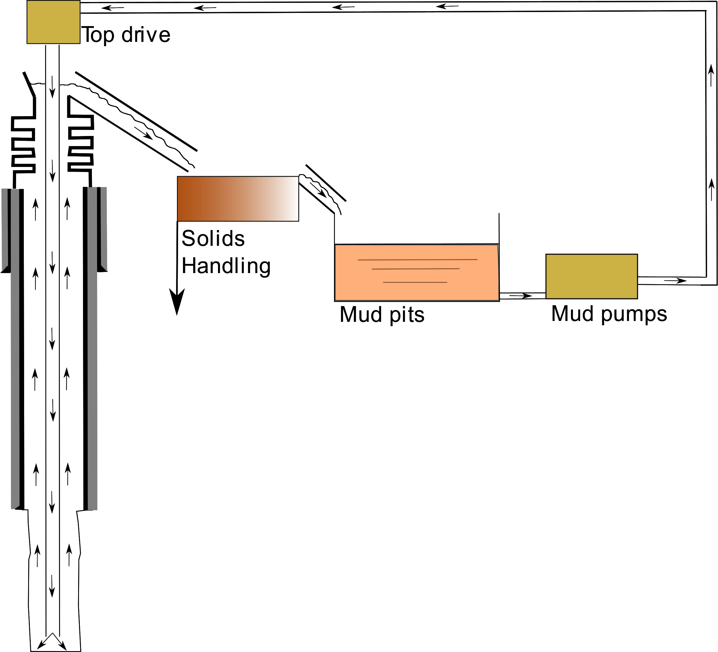
Drilling
Drilling fluid, “mud” is circulated continuously down the drill string, cooling the bit and transporting cuttings to the surface
Drillstring rotation provided by topdrive
Bit rotation provided by the topdrive and mud motor if one is installed
Drillstring supported by drawworks
Weight on bit provided by drillstring mass and gravity

Slide 4
Drilling challenges
A significant amount of non-productive time (NPT) is attributed to “stuck pipe”
A significant part of this can be attributed to hole cleaning problems
The limiting factor for the depth of many wells drilled on land is not being able to get “weight on bit”
Using downhole tools that cannot turn when drillsting rotates
A significant part of downhole tool failures and pipe failures are dynamic resonance phenomena for the drillstring and bottom hole assembly

Slide 5
Drilling challenges
This can be improved by increased understanding of the phenomena involved
What should my expected topdrive torque be?
Are cuttings transported out of the well?
Is my drillstring prone to resonances, and how can I detect and deal with them?

Slide 6
Drilling
Drilling challenges
Digital twins
Drillstring torque and drag, introduction
Cuttings transport, introduction
State of the art
Future?
Summary

Slide 7
Digital twins
“Digital twins”
Forecasted in 1991 in the Book “Mirror Worlds” [1]
Concept introduced by Michael Grieves in 2002 for product lifecycle management, name coined by John Vickers of NASA and referred to as “Digital Twin” by Grieves in 2011 [2]
A phrase with a lot of different interpretations
Grives gives separate classifications of digital twin types that are very helpful in dealing with conflicting interpretations of the concept

Slide 8
Digital twins
Digital twin types [2]
Digital twin prototype (DTP)
Models for a product in the design stage
More or less all modern products have DTP’s, even a paperclip
Digital twin instance (DTI)
Model running alongside a produced artifact
Most modern systems with control loops etc. will to some extent have DTI’s
Digital twin aggregates (DTA’s)
Composite of all DTI’s with historical data
The “holy grail”. To a large extent what was forecasted by David Gelernter in “Mirror Worlds” [1]
Perhaps what causes the hype?

Slide 9
Digital twins
Our “product” is the well under construction
Digital twin prototype (DTP)
Simulations of any fidelity performed prior to drilling the well are DTP’S
DTP’s can often be very high fidelity (no Realtime requirement)
Computational Fluid Dynamics (CFD) and Finite Element Models (FEM) are typical high fidelity DTP’s
Digital twin instance (DTI)
Models of different fidelity, but often limited by requirements of Realtime computational performance
Using information from DTP’s in an operational context without connection to the system can be argued being an instance of DTI’s
Digital twin aggregates (DTA’s)?

Slide 10
Drilling
Drilling challenges
Digital twins
Drillstring torque and drag, introduction
Cuttings transport, introduction
State of the art
Future?
Summary

Slide 11
Building Digital Twins

Slide 12
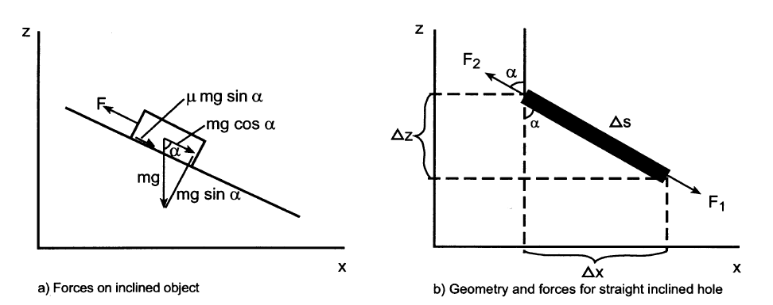
Drillstring torque and drag
Aadnøy, Bernt S, and Ketil Andersen. ‘Design of Oil Wells Using Analytical Friction Models’. Journal of Petroleum Science and Engineering 32, no. 1 (December 2001): 53–71. https://doi.org/10.1016/S0920-4105(01)00147-4. [3]

Slide 13
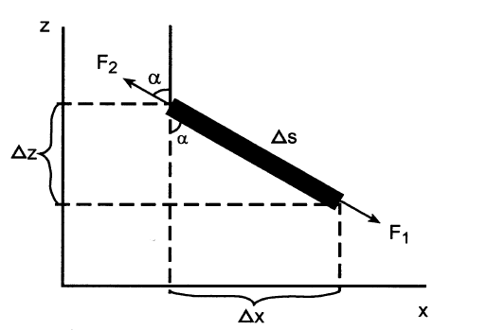
Drillstring torque and drag
Simplified example
Force balance for drillstring in inclined hole
$F_{2}=F_{1}+F_{gravity}±F_{friction}$
Aadnøy, Bernt S, and Ketil Andersen. ‘Design of Oil Wells Using Analytical Friction Models’. Journal of Petroleum Science and Engineering 32, no. 1 (December 2001): 53–71. https://doi.org/10.1016/S0920-4105(01)00147-4. [3]

Slide 14
Drillstring torque and drag
$$F_{2}=F_{1}+F_{gravity}±F_{friction}$$
$$F_{gravity}=w Δs g cos(α)$$
$$w−drillpipe weight per meter in fluid \left[\frac{kg}{m}\right]$$
$w=w_{drillstring}(1−\frac{ρ_{mud}}{ρ_{drillpipe}}$)
Coulomb friction
$$F_{friction}=μF_{N}$$
$F_{friction}=μ(w Δs g sin\left(α\right)$)
$$F_{2}=F_{1}+wΔsg(\cos\left(α\right)±μ\sin\left(α\right))$$
Aadnøy, Bernt S, and Ketil Andersen. ‘Design of Oil Wells Using Analytical Friction Models’. Journal of Petroleum Science and Engineering 32, no. 1 (December 2001): 53–71. https://doi.org/10.1016/S0920-4105(01)00147-4. [3]

Slide 15
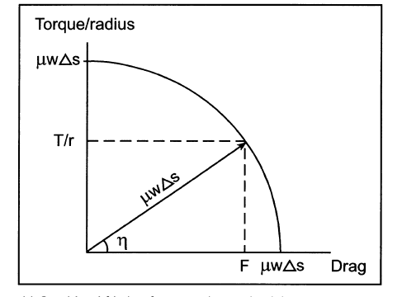
Drillstring torque and drag
Similar for Torque
$T={rF}_{friction}$
$T=$ $rμ(w Δs g sin\left(α\right)$)
Simultaneous hoisting/lowering and rotation
$F_{friction}$ has the same magnitude, but has to be decomposed into torque and drag!
$${\left(\frac{T }{r}\right)}^{2}+F_{axial}^{2}=F_{friction}^{2}$$
$η=\tan^{−1}{(\frac{v_{t}}{v_{a}})}$
$$v_{t}=rω_{drillstring}$$
Aadnøy, Bernt S, and Ketil Andersen. ‘Design of Oil Wells Using Analytical Friction Models’. Journal of Petroleum Science and Engineering 32, no. 1 (December 2001): 53–71. https://doi.org/10.1016/S0920-4105(01)00147-4. [3]

Slide 16
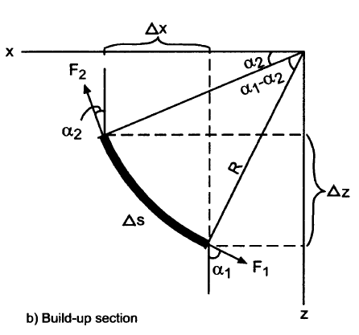
Drillstring torque and drag
In reality curves in the well complicate matters
Forces $F_{1}$ and $F_{2}$ not parallel (along a single line)
This results in a net force on the element that can lift the drillstring, and force it into the upper part or side of the wellbore, depending on $F_{1}$ and $F_{2}$
Two main approaches
Soft string
String treated as a non-rigid “cable” or “chain”
Bending/shear forces in the string neglected
Stiff string
Aadnøy, Bernt S, and Ketil Andersen. ‘Design of Oil Wells Using Analytical Friction Models’. Journal of Petroleum Science and Engineering 32, no. 1 (December 2001): 53–71. https://doi.org/10.1016/S0920-4105(01)00147-4. [3]

Slide 17
Drillstring torque and drag
If considering soft string, analytical solutions to friction exist [3][4]
Since friction becomes a function of axial forces, the equations have to be integrated
Stiff string models introduce more degrees of freedom and are more computationally expensive
Other factors can be important:
Viscous drag from fluid acting on drillstring
Tortuosity of wellbore
Buckling of drillstring
Mirhaj, S. A., E. Kaarstad, and B. S. Aadnoy. “Torque and Drag Modeling; Soft-String versus Stiff-String Models.” In SPE/IADC Middle East Drilling Technology Conference and Exhibition. Abu Dhabi, UAE: Society of Petroleum Engineers, 2016. https://doi.org/10.2118/178197-MS. [5]

Slide 18
Drillstring torque and drag
Dynamics of the drillstring
Torsional and axial forces are transmitted through the drillstring as waves traveling at non-neglible speeds. [6]
This leads to many resonance phenomena that can cause problems in operation
Stick slip (torsional resonance)
Bit-bounce (axial resonance)
Whirl (lateral resonances/modal coupling)
Forward
Backward
Chaotic

Slide 19
Drillstring torque and drag
Dynamics of the drillstring, stick slip

Slide 20
Drillstring torque and drag
Dynamics of the drillstring, whirl

Slide 21
Drilling
Drilling challenges
Digital twins
Drillstring torque and drag, introduction
Cuttings transport, introduction
State of the art
Future?
Summary

Slide 22
Modelling of cuttings transport
One of the primary tasks for the drilling fluid is transporting cuttings out of the well
For the well, there are three “regions” of cuttings transport phenomena [7]
0-30° inclination (near vertical)
30-60°(intermediate)
60-90°(horizontal)
For near vertical sections, 0-30°, hole cleaning is the easiest as cuttings do not tend to form beds
All cuttings suspended in liquid
Transported at $v_{cuttings}=v_{liquid}−v_{settling}$

Slide 23
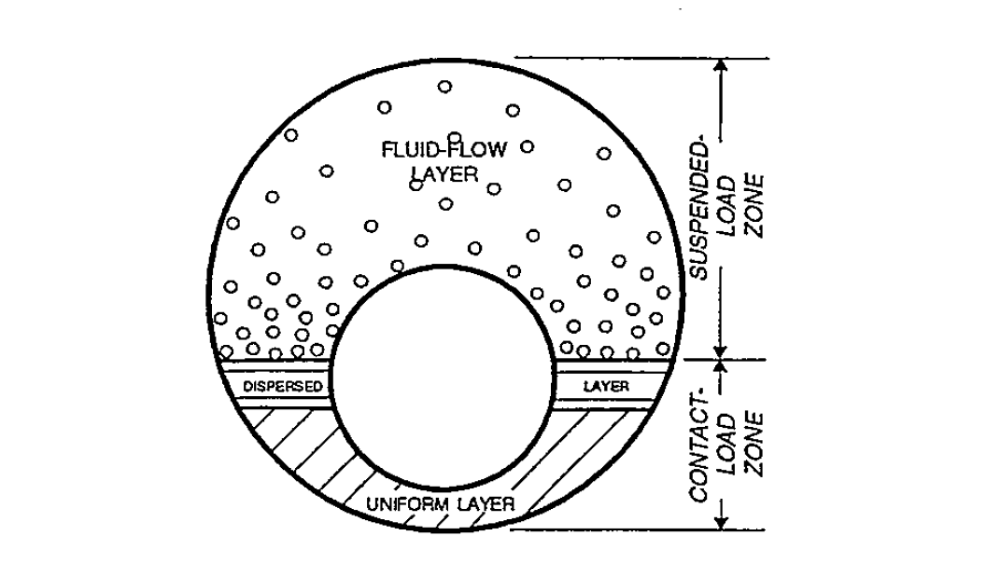
Modelling of cuttings transport
For near horizontal sections, 60-90°, cuttings tend to form stable cuttings beds along the wellbore
Nguyen, D. “Mathematical Models off Cuttings Transport & Drilling Fluid Displacement By Cement Slurry In Horizontal Wells.” PhD Thesis, 1997. [8]

Slide 24
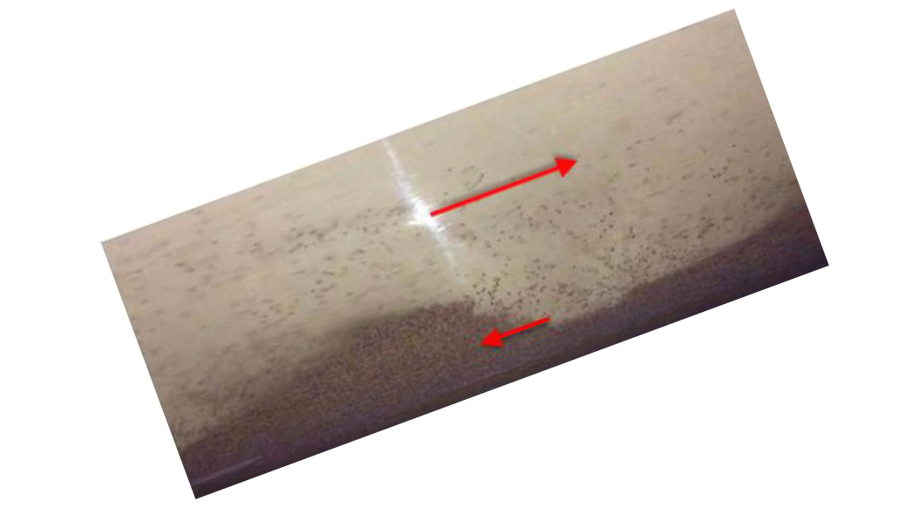
Modelling of cuttings transport
For intermediary inclinations of 30-60° unstable cuttings beds form
These beds can cause a “cuttings avalanche” when pumps are stopped
Pandya, Soham, Ramadan Ahmed, and Subhash Shah. “Wellbore Cleanout in Inclined and Horizontal Wellbores: The Effects of Flow Rate, Fluid Rheology, and Solids Density.” SPE Drilling & Completion 35, no. 01 (March 1, 2020): 048–068. https://doi.org/10.2118/194240-PA. [7]
Cuttings beds, and high cuttings concentration will have effect on torque/drag and hydraulics!

Slide 25
Modelling of cuttings transport
If averaging over the cross sectional area, transport of cuttings can be described by a Partial Differential Equation (PDE), representing the conservation of mass for cuttings in the system
$\frac{∂ρ_{c}α_{c}}{∂t}+\frac{∂ρ_{c}α_{c}v_{c}}{∂x}=0$
The transport velocity $v_{c}$ is challenging to model in deviated and horizontal wellbores
Increase in variable | $$v_{c}$$
$$ρ_{l}$$
$$ρ_{c}$$
$$v_{l}$$
$$ω$$
Eccentricity (pipe at bottom)
Rheology | - turbulent laminar

Slide 26
Modelling of cuttings transport
Both empirical and first principles based models exist for $v_{c}$
Can also be split into multi-layer transport models where the transport velocity for the cuttings bed, near bed suspended particles and fully suspended flow are described by individual velocities
Position and rotation of drillstring significantly affect cuttings bed height and transport in deviated and horizontal wellbores, (30-90°) [9]

Slide 27
Drilling
Drilling challenges
Digital twins
Drillstring torque and drag, introduction
Cuttings transport, introduction
State of the art
Future?
Summary

Slide 28
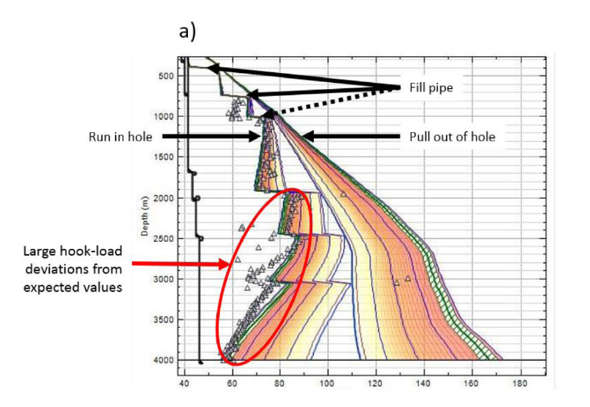
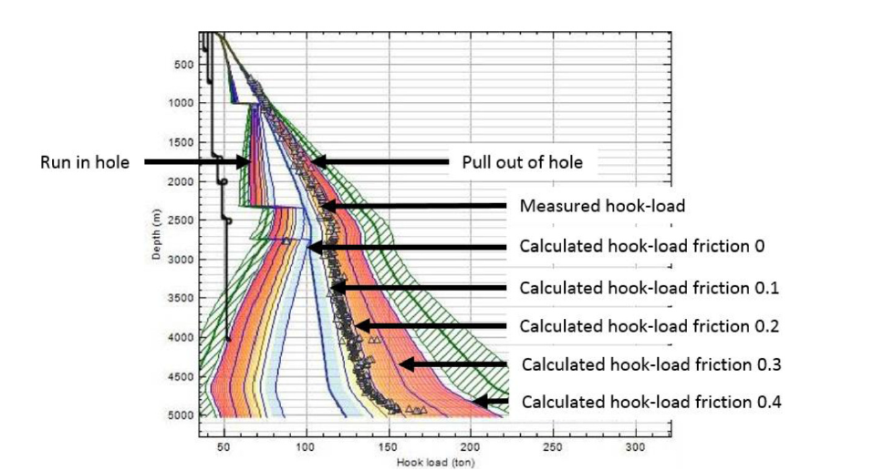
State of the art
Using torque/drag statics calculations during operation for predicting expected hook load
Deviation from expected torque/drag often caused by hole cleaning challenges
Cayeux, Eric, Amare Leulseged, Roald Kluge, and Jarle Haga. “Use of a Transient Cuttings Transport Model in the Planning, Monitoring and Post Analysis of Complex Drilling Operations in the North Sea.” In IADC/SPE Drilling Conference and Exhibition. Fort Worth, Texas, USA: Society of Petroleum Engineers, 2016. https://doi.org/10.2118/178862-MS. [10]

Slide 29
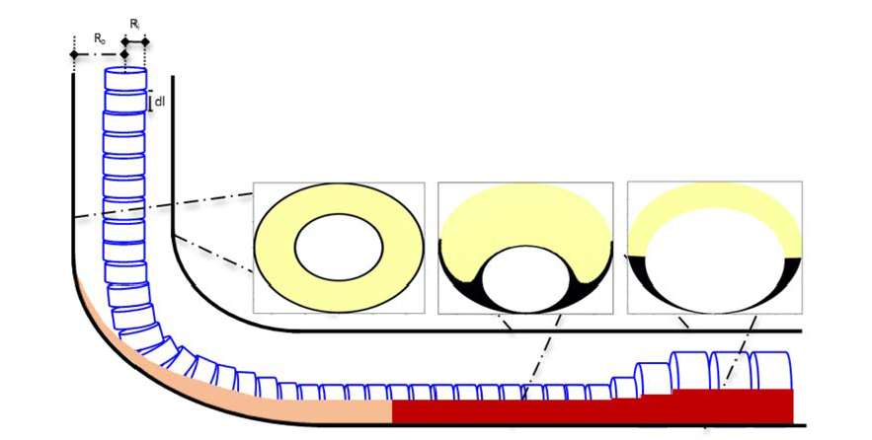
State of the art
Real time modeling (DTI’s) of cuttings transport to predict hole cleaning conditions is an active research field [9,10,11]
Main challenges is due to complex interactions between cuttings, liquid flow and drillstring rotation and position affecting cuttings bed and transport velocities in sections where beds are formed
Erge, Oney, and Eric van Oort. “Modeling Cuttings Transport and Annular Pack-Off Using Local Fluid Velocities with the Effects of Drillstring Rotation and Eccentricity.” In IADC/SPE International Drilling Conference and Exhibition. Galveston, Texas, USA: Society of Petroleum Engineers, 2020. https://doi.org/10.2118/199587-MS. [9]

Slide 30
State of the art
These challenges still require experimental work for increasing understanding of interactions and relation between controlling parameters [8,12,13]
Inherently a transient 3D problem considering hydraulics and drillstring dynamics
Large range of “reasonable” and unknown parameter values is a challenge with mechanistic models
A very interesting approach is that of using high fidelity Computational Fluid Dynamics (CFD) models to supplement experimental data [13]
Another interesting approach is using Artificial Neural Networks (ANN’s) to represent the complex interactions of controlling parameters to estimate cuttings transport velocity $v_{c}$ where this can be used in a PDE transport model [14,15], especially with using CFD for providing training data
Hybrid approach where dynamics are handled “conventionally” and non-linear mapping from process conditions by neural-network

Slide 31
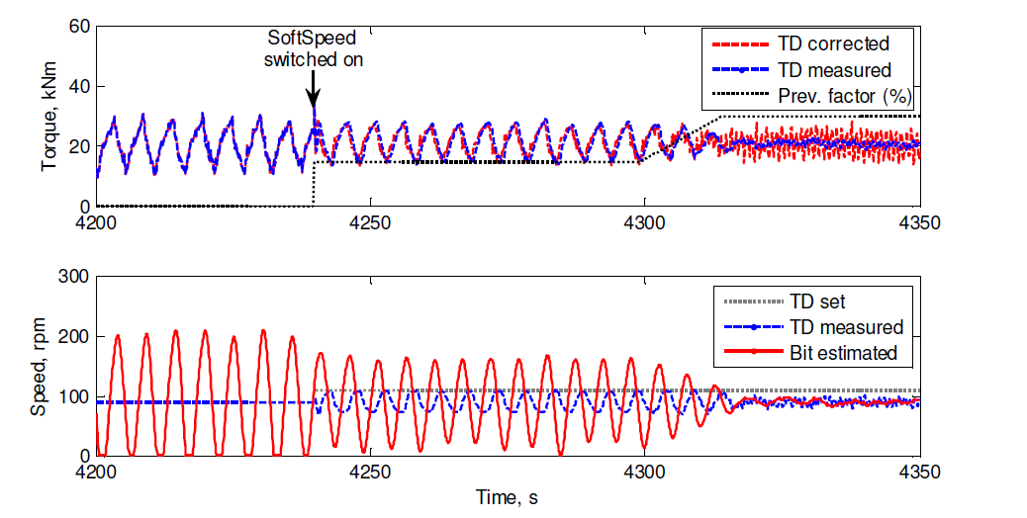
State of the art
Drillstring dynamics are commonly modeled to estimate torsional resonance modes
Stick slip problems can be mitigated by soft-torque or soft-speed controllers that limit reflection of torsional waves at surface [16]
Some of this was enabled through the increased use of variable frequency drives (VFD) for the topdrive
These controllers are very much examples of success stories with DTP’s and DTI’s
Kyllingstad, Age, and Pal Jacob Nessjøen. “A New Stick-Slip Prevention System.” In SPE-119660-MS, 14. Amsterdam, The Netherlands: Society of Petroleum Engineers, 2009. https://doi.org/10.2118/119660-MS. [16]

Slide 32
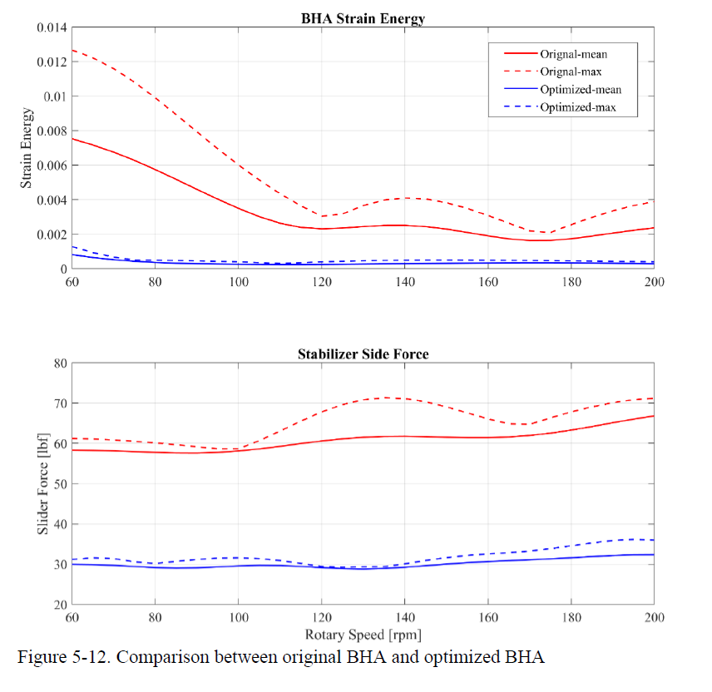
State of the art
As computers get faster and more parallel, stiff string FEM models can run at speeds where derivative free optimization of bottomhole assembly configurations are becoming possible [17]
Modern accelerometers have had a dramatic reduction of size and cost and an increase in accuracy over the last years
Tianheng Feng. “Modeling and Control of Drillstring Dynamics for Vibration Suppression.” PhD Thesis, The University of Texas at Austin, 2019. [17]

Slide 33
State of the art
Digital twin aggregates?
For drilling, the “product” is the well, and in general the product is not uniform
Wells are different
This pose challenges with typical “data-driven” methods in DTA’s
DTA’s strength can often be datamining and correlation over causality
Another significant challenge for the drilling industry is the business model used, where different service providers do different tasks on the rig
This restricts the flow of data between for instance mud-engineering, downhole components and drilling.
Especially in the real-time data sense
Traditionally, access to data is restrictive in the drilling industry

Slide 34
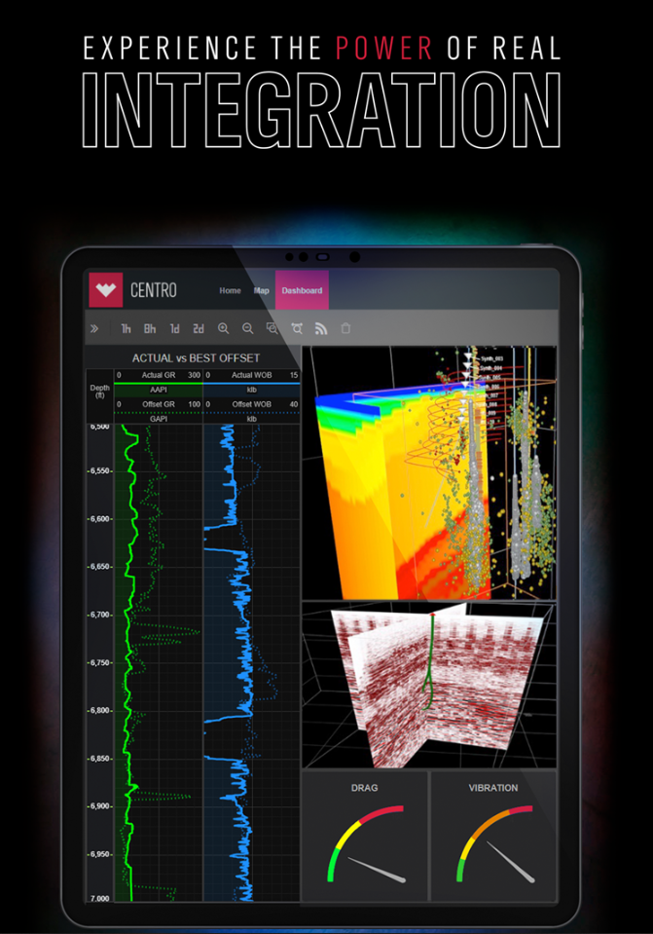
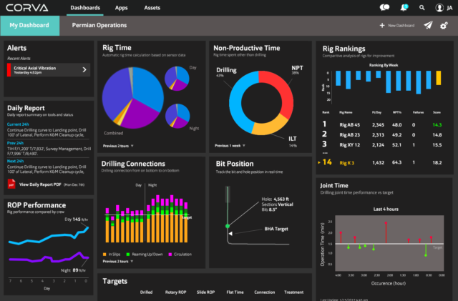
State of the art
Future
Digital Twin Aggregates or «mirror worlds» are starting to happen in the drilling industry now
This is about the data, just as much as the models
Weatherford Centro
Corva.ai

Slide 35
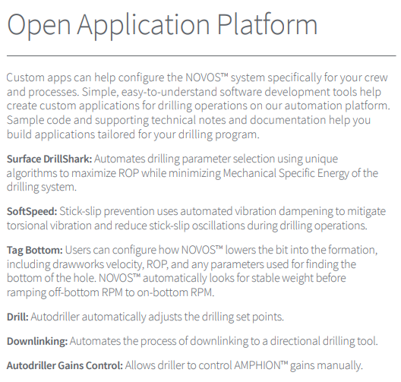
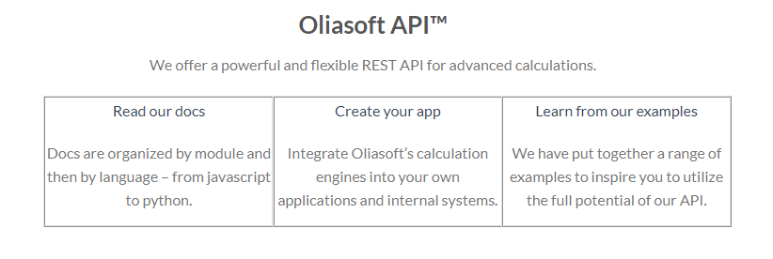
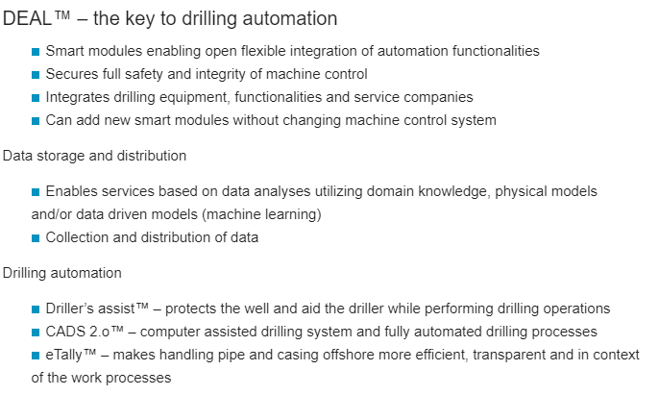
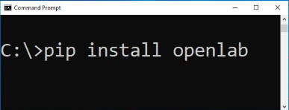
State of the art
Future
Parts of the industry are starting to have an open API approach that can enable this, also by companies that are not the biggest players.
Oliasoft API
mhwirth DEAL
NOV NOVOS
OpenLab python client

Slide 36
Summary
Using torque/drag statics calculations to find expected torque/drag and thus diagnose downhole problems works well
Understanding of drillstring torque/drag dynamics can mitigate resonance problems
Stick slip can be mitigated by better topdrive controllers
Optimisation of BHA configurations using stiff string FEM models is possible
Lateral resonance modes can not be detected by surface measurements
Real time cuttings transport modelling is making progress
Biggest challenge is still large number of uncertain parameters that have a large reasonable range for mechanistic models

Slide 37
Summary
Digital twin aggregates (DTA’s) are on the horizon
This is just as much about the data and data analytics as the models
Correlation as interesting as cause
Challenges with this:
Wells are not uniform
Data flow is restricted

Slide 38
The mirror world will not solve all your questions, make you brilliant or teach you Japanese. It will merely rub your nose in the big picture.
David Gelertner, Mirror Worlds [1]

Slide 39
Thank You
kelda.no

Slide 40
References
[1] Gelernter, David. Mirror Worlds or the Day Software Puts the Universe in a Shoebox: How Will It Happen and What It Will Mean. USA: Oxford University Press, Inc., 1991.
[2] Flumerfelt, Shannon, Katherine G. Schwartz, Dimitri Mavris, and Simon Briceno, eds. Complex Systems Engineering: Theory and Practice. Reston, VA: American
Institute of Aeronautics and Astronautics, Inc., 2019. https://doi.org/10.2514/4.105654.
[3] Aadnøy, Bernt S, and Ketil Andersen. “Design of Oil Wells Using Analytical Friction Models.” Journal of Petroleum Science and Engineering 32, no. 1 (December 2001): 53–71. https://doi.org/10.1016/S0920-4105(01)00147-4.
[4] Fazaelizadeh, Mohammad. “Real Time Torque and Drag Analysis during Directional Drilling.” PhD Thesis, University of Calgary, 2013.
[5] Mirhaj, S. A., E. Kaarstad, and B. S. Aadnoy. “Torque and Drag Modeling; Soft-String versus Stiff-String Models.” In SPE/IADC Middle East Drilling Technology Conference and Exhibition. Abu Dhabi, UAE: Society of Petroleum Engineers, 2016. https://doi.org/10.2118/178197-MS.
[6] Chin, W.C. “Wave Propagation in Drilling, Well Logging and Reservoir Applications.” Wave Propagation in Drilling, Well Logging and Reservoir Applications, January 1, 2014, 1–418. https://doi.org/10.1002/9781118925935.
[7] Pandya, Soham, Ramadan Ahmed, and Subhash Shah. “Wellbore Cleanout in Inclined and Horizontal Wellbores: The Effects of Flow Rate, Fluid Rheology, and Solids Density.” SPE Drilling & Completion 35, no. 01 (March 1, 2020): 048–068. https://doi.org/10.2118/194240-PA.
[8] Nguyen, D. “Mathematical Models off Cuttings Transport & Drilling Fluid Displacement By Cement Slurry In Horizontal Wells.” PhD Thesis, 1997.
[9] Erge, Oney, and Eric van Oort. “Modeling Cuttings Transport and Annular Pack-Off Using Local Fluid Velocities with the Effects of Drillstring Rotation and Eccentricity.” In IADC/SPE International Drilling Conference and Exhibition. Galveston, Texas, USA: Society of Petroleum Engineers, 2020. https://doi.org/10.2118/199587-MS.
[10] Cayeux, Eric, Amare Leulseged, Roald Kluge, and Jarle Haga. “Use of a Transient Cuttings Transport Model in the Planning, Monitoring and Post Analysis of Complex Drilling Operations in the North Sea.” In IADC/SPE Drilling Conference and Exhibition. Fort Worth, Texas, USA: Society of Petroleum Engineers, 2016. https://doi.org/10.2118/178862-MS.

Slide 41
References
[11] Cayeux, Eric, Taiwo Mesagan, Sakti Tanripada, Mohamed Zidan, and Kjell Kåre Fjelde. “Real-Time Evaluation of Hole-Cleaning Conditions With a Transient Cuttings-Transport Model.” SPE Drilling & Completion 29, no. 01 (March 1, 2014): 05–21. https://doi.org/10.2118/163492-PA.
[12] Busch, A, and S T Johansen. “Cuttings Transport Modeling - Part 1: Specification of Benchmark Parameters with a Norwegian Continental Shelf Perspective,” n.d., 32.
[13] Busch, Alexander, Benjamin Werner, and Stein T. Johansen. “Cuttings Transport Modeling Part 2: Dimensional Analysis and Scaling.” SPE Drilling & Completion 35, no. 01 (March 1, 2020): 069–087. https://doi.org/10.2118/198907-PA.
[14] Agwu, Okorie E., Julius U. Akpabio, and Adewale Dosunmu. “Artificial Neural Network Model for Predicting Drill Cuttings Settling Velocity.” Petroleum, December 2019, S2405656119301142. https://doi.org/10.1016/j.petlm.2019.12.003.
[15] Rooki, Reza, Faramarz Doulati Ardejani, and Ali Moradzadeh. ‘Hole Cleaning Prediction in Foam Drilling Using Artificial Neural Network and Multiple Linear Regression’. Geomaterials 04, no. 01 (2014): 47–53. https://doi.org/10.4236/gm.2014.41005.
[16] Kyllingstad, Age, and Pal Jacob Nessjøen. “A New Stick-Slip Prevention System.” In SPE-119660-MS, 14. Amsterdam, The Netherlands: Society of Petroleum Engineers, 2009. https://doi.org/10.2118/119660-MS.
[17] Tianheng Feng. “Modeling and Control of Drillstring Dynamics for Vibration Suppression.” PhD Thesis, The University of Texas at Austin, 2019.

